Slide 1

Programming for Engineers in Python
Fall 2019-2020
Lecture 1: Introduction to Python

Slide 2

Programming for Engineers in Python
Welcome to the course!
We will learn to program in Python.
Goal: enable you to use programming as a tool for solving “real world” problems.
Hard work is required!
Notes:
2

Slide 3
Course websites
1. Course website: http://courses.cs.tau.ac.il/pyProg/1920a/
Administration
Course schedule
Lecture and recitation presentations
Code examples
Assignments
Homework guidelines
2. MOODLE website: https://moodle.tau.ac.il/course/view.php?id=509182099
Homework submissions
Forums (General + assignment specific)

Slide 4
Recitations
Practical Sessions
In a standard classroom
Purposes:
Practice topics presented in class.
Background for homework assignments.
Learn practical tools.
Lectures are usually harder to understand, and it is OK.
Notes:
4

Slide 5
Guided Lab
Optional practical session in a computer lab
Technical support (IDLE, Python files, etc.)
Notes:
5

Slide 6
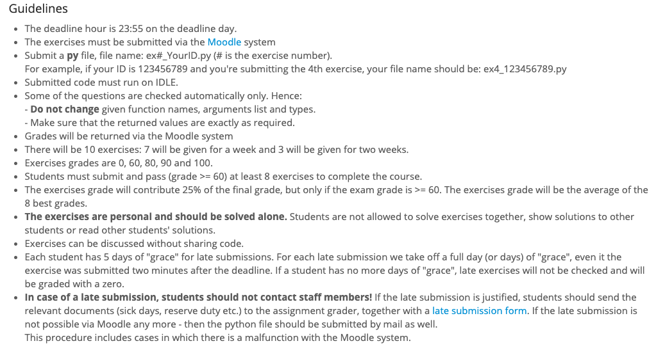
Homework
Guidelines on the course website:
Notes:
6

Slide 7

A Personal Note on HW
It will take you a lot of time and effort to make the code work.
But
There is no other way to learn how to program
Notes:
7

Slide 8
The Exam
Final grade is composed out of homework and final exam
You must pass the exam to pass the course
Written exam
Includes all course material:
Lectures, recitations, and HW
Notes:
8

Slide 9
Course Objectives
Develop basic programming and algorithmic skills
(not how computer hardware works)
Notes:
9

Slide 10
Preface
We assume no prior knowledge.
However, we advance fast.
The only way to keep on track is to practice!
Notes:
10

Slide 11
Syllabus
Python programming basics
File I/O
Error Handling
Recursion
Sort & Search algorithms
Object-Oriented Programming
Data analysis using Numpy
Scientific Calculations using Numpy
Image Processing
Advance Topics
Notes:
11

Slide 12
Resources
Course slides and pointers to relevant bibliography.
Recommended resources:
Book: Think Python, by Allen B. Downey (http://greenteapress.com/thinkpython/thinkpython.html)
Manual: Python 3.7 documentation https://docs.python.org/3.7/ (the official language manual)
Notes:
12

Slide 13

Questions?

Slide 14

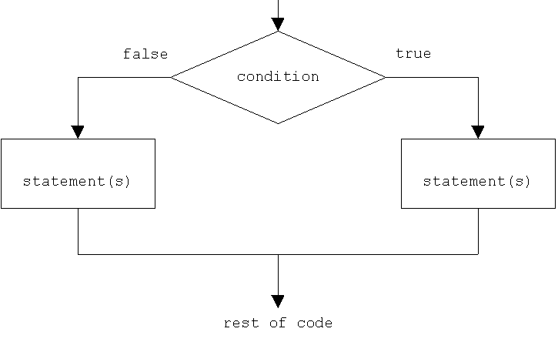
Today
Brief background to programming
Python basics:
Variables
Numbers
Strings
Arithmetic Operators
Comparison Operators
Logical Operators
Branching (if)
Notes:
14

Slide 15
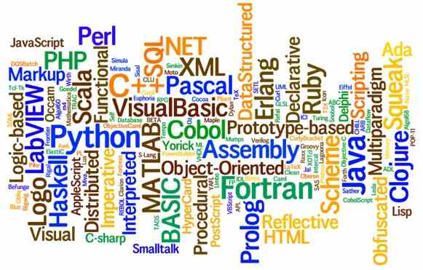
Programming Languages Basics
A computer program is a sequence of text instructions that can be “understood" by a computer and executed.
A programming language is a machine-readable artificial language designed to express computations that can be performed by a computer.
Over 500 different computer languages
are listed by Wikipedia
Notes:
15

Slide 16
Machine Code (Language)
Computers understand only machine language.
Basically looks like a sequence of 1’s and 0’s.
Very inconvenient to work with and non-intuitive.
Computer languages were created for human convenience.
The computer does not understand C/Python/Java - They must be “translated” into machine language
In this course, we do not care how the computer does that

Slide 17
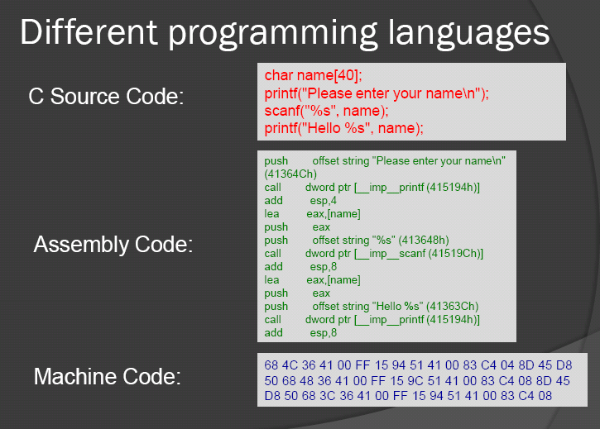
Computer Program
A sequence of instructions designed to achieve a specific purpose
The instructions are executed sequentially. No instruction is executed before the previous is completed

Slide 18

Language Selection and Python
Python (since 1991):
Quick development
Easy to learn
Huge community
Short development-execution rounds
Fast enough for most applications
Python is widely industrial used
(Facebook, Google, IDF, NASA, ect.)
Cross-platform
Guido van Rossum

Slide 19
Installing and Running Python 3.7
Python 3.7 is already installed in the computers’ lab.
Install Anaconda distribution for Python 3.7 from here:
https://www.anaconda.com/distribution/#download-section
Choose windows / MacOS / Linux
Choose 32-bit or 64-bit installer, according to your computer
The Anaconda package includes everything you need:
Python’s interpreter required for running Python programs
Python editors for writing Python programs (i.e. IDLE, Spyder)
Many useful Python extension packages (i.e. Numpy, Pandas)
Do not install Python 2.7
Regular python installation available here: http://python.org/download/
Notes:
19

Slide 20
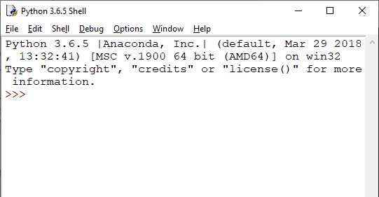
Using Anaconda
Run idle.exe to open the Idle terminal.
The executable file is located in INSTALL_DIR\Anaconda\Scripts
(INSTALL_DIR stands for the installation directory, for example: C:\Program Files)
It is recommended to create a shortcut on your desktop.
This is how idle shell
looks like:
A video on working with IDLE: http://www.youtube.com/watch?v=lBkcDFRA958
Notes:
20

Slide 21
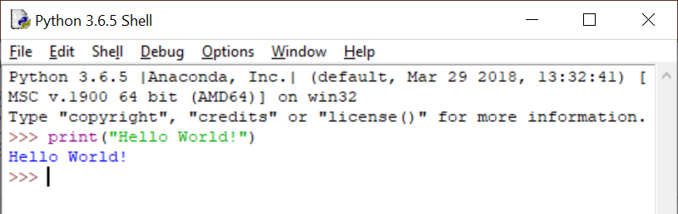
My First Python Program: Hello World!
Separate commands typed in Python’s shell are executed by Python’s interpreter, and the output is printed to the screen.
For longer programs, we will assemble several commands into a script (program) and save it to a .py file which can be executed.

Slide 22
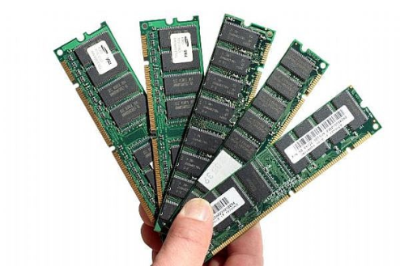
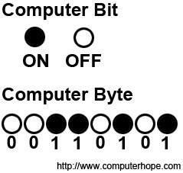
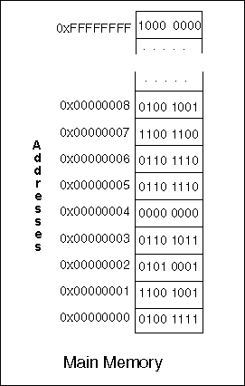
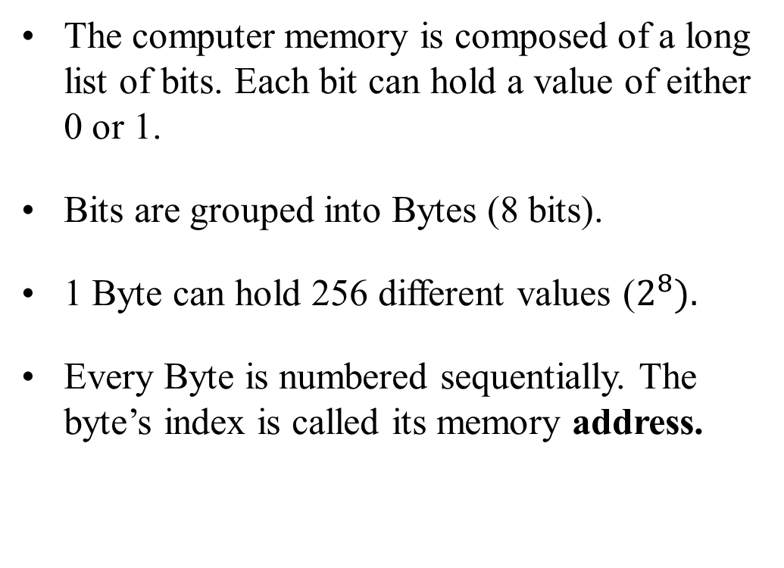
Computer’s Memory
The computer memory is composed of a long list of bits. Each bit can hold a value of either 0 or 1.
Bits are grouped into Bytes (8 bits).
1 Byte can hold 256 different values ($2^{8}).$
Every Byte is numbered sequentially. The byte’s index is called its memory address.

Slide 23
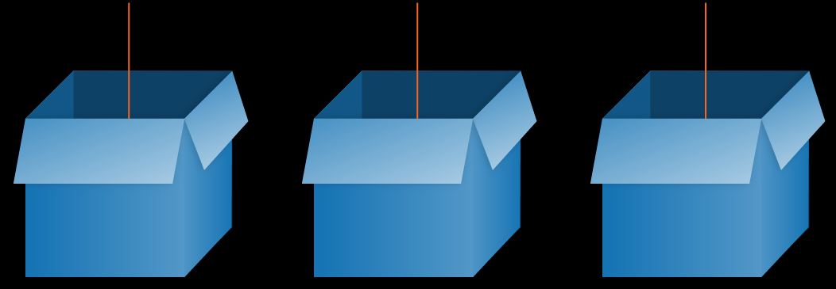
Using variables to store data in memory
Computer programs manipulate data.
Data is given either as input or calculated by the program.
To access it later, data must be remembered.
Therefore, computer programs use variables to store data in the memory.
Each variable has…
A value (content, the stored data)
A name (a shortcut to its address in memory)
A type (str, int, float, bool)
“Bob” True 35
s r age
str bool int

Slide 24
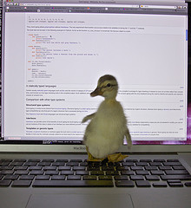
Program variables
Each variable has: Name, Value, Type (and an Address of the location in memory where its value is stored).
In Python we create variables simply by assigning a value to a variable name:
s = "Bob“
r = True
age = 35
The variable’s type is automatically determined in Python based on its assigned values and actions (“duck typing”)
"Bob" True 35
s r age
str bool int

Slide 25
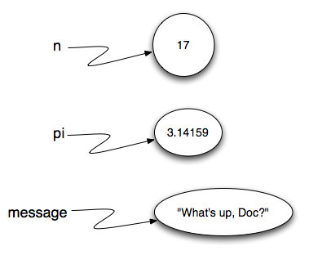
Data Types in Python
Commonly used built in data types:
Numeric types: int, float, complex
Boolean: bool
String: str
Why do we need different types?
Saves memory
Execution speed
Types have different actions
b
True

Slide 26
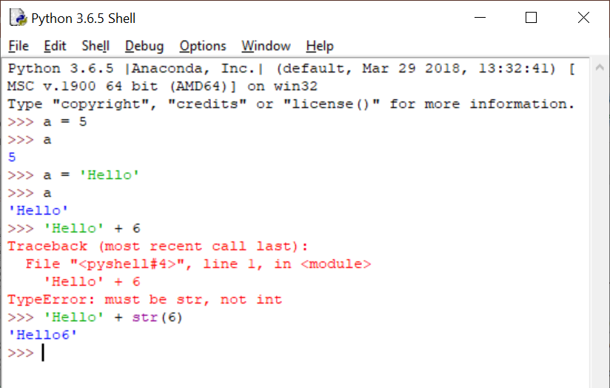
Hands On
Notes:
26

Slide 27
The ‘type’ command returns the type of a variable/expression
An integer number
>>> type(4)
<class 'int'>
>>> type(3.14159)
<class 'float'>
A real number (floating point)

Slide 28
Variables and Assignments
Left-hand side is a variable.
Right-hand side is an expression.
>>> n = 10
>>> m = (10 + 4) * 5
The interpreter:
1. Evaluates the expression
2. Assigns its value to the variable.
n
m
10
70
Variable's name - a sequence of letters and digits,
starting with a letter.

Slide 29
Variables and Assignments: An Example
Changing the value of a variable:
>>> n = 11
>>> n
11
Changing the type of a variable:
>>> n = 1.3141
>>> n
1.3141
Variables can be used in expressions:
>>> pi = 3.14159
>>> pi * 2 + 1
7.28318

Slide 30
Variables and Assignments – Cont.
Referring to undefined variables leads to runtime error
>>> check_this
Traceback (most recent call last):
File "<pyshell#6>", line 1, in <module>
check_this
NameError: name 'check_this' is not defined

Slide 31
Arithmetic Operators
Operator | Use | Description
+ | x + y | Sum of x and y
- | x - y | Subtracts y from x
* | x * y | Multiplies x by y
** | x ** y | x to the power y
/ | x / y | Divides x by y
// | x // y | Integer division of x by y: returns the floor of the division(rounded to the nearest integer below the division value).
% | x % y | Modulo: the remainder of dividing x by y
What’s the type of 8/5 ? And of 8//5 ?

Slide 32
Playing with Variables
>>> a = 3
>>> a
3
>>> b = 5
>>> b
5
>>> c = a + b
>>> c
8
>>> c = c * 2
>>> c
16
>>> b**a
125
>>> b / a
1.6666666666666667
>>> b // a
1
>>> b % a
2
Notes:
8
16
16
13

Slide 33
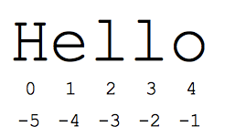
Strings
String variables are used to save text.
An ordered sequence of characters.
>>> s = "Hello"
>>> print(s)
Hello
>>> print(s[0])
H
>>> print(s[-2])
l

Slide 34
Strings Indices
>>> a = 'Hello'
>>> str.find(a, 'H')
0
>>> a[0]
'H'
>>> a[1]
'e'
>>> a[-1]
'o'
>>> a[4]
'o'
>>> a[5]
Traceback (most recent call last):
File "<pyshell#29>", line 1, in <module>
a[5]
IndexError: string index out of range
>>>
Notes:
34

Slide 35
String Access
>>> a = 'Hello'
>>> a[1]
'e'
>>> a[1:3]
'el'
>>> a[1:]
'ello'
>>> a[-4:-2]
'el'
>>> a[:-3]
'He'
>>> a[-3:]
'llo’
H | e | l | l | o
0 | 1 | 2 | 3 | 4
-5 | -4 | -3 | -2 | -1

Slide 36
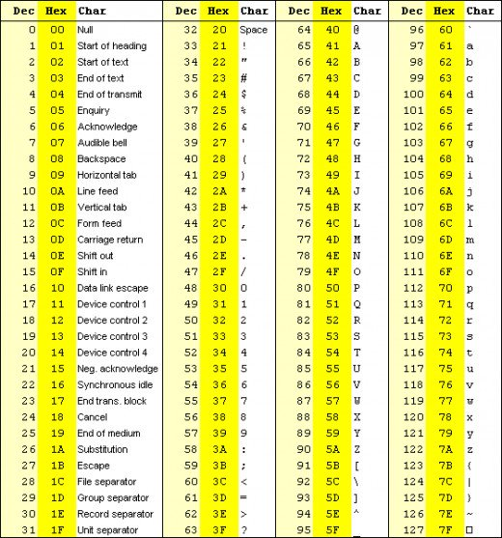
Strings are a sequence of characters
ASCII table.
Every character in a string is mapped to a specific number based on the famous ASCII table.
Strings are saved in memory as a sequence of numbers in binary form.
In python:
\n represents new line
\t represents tab
Notes:
36

Slide 37
String Type
>>> a = 'Hello'
>>> type(a)
<class 'str'>
>>> len(a)
5
>>> a + "world"
'Helloworld'
>>> a
'Hello'
>>> # strings are immutable
>>> str.lower(a)
'hello'
>>> a
'Hello'
Notes:
37

Slide 38
Strings concatenation
>>> s1 = "He"
>>> s2 = "llo"
>>> s3 = s1 + s2
>>> s3
'Hello'
>>> s4 = s3 + " World"
>>> c = "!"
>>> print (s4+” “+str(2019)+” “+c)
Hello World 2019 !
>>> print (s4, 2019, c) # automatically adds spaces in between
Hello World 2019 !
>>> print (1,2,3) #Default: space as sep, new line as end
1 2 3
>>> print (1,2,3,sep=' ',end='\n')
1 2 3
>>> print (1,2,3,sep='-',end=''); print (4,5,6,sep='-')
1-2-34-5-6

Slide 39
Strings are Immutable
You cannot mutate (change) existing strings. Only create new ones !
>>> a = "abc"
>>> a[0] = 'a'
Traceback (most recent call last):
File "<pyshell#21>", line 1, in <module>
a[0]='a'
TypeError: 'str' object does not support item assignment
However, pointing to another string is valid:
>>> a="abc"
>>> a="gggg"
Immutable variables cannot be changed after created.
Applying operations on immutable variables usually return a new variable rather changing the original variable
Notes:
39

Slide 40
Special characters and string operators
http://www.tutorialspoint.com/python/python_strings.htm
Special characters: \n (new line) \t (tab)
Special string operators:
a = 'Hello', b = 'Python'
Operator | Description | Example
+ | Concatenation - Adds values on either side of the operator | a + b will give 'HelloPython'
* | Repetition - Creates new strings, concatenating multiple copies of the same string | a*2 will give 'HelloHello'
[] | Slice - Gives the character from the given index | a[1] will give 'e'
[ : ] | Range Slice - Gives the characters from the given range | a[1:4] will give 'ell'
in | Membership - Returns true if a character exists in the given string | 'H' in a will give True
not in | Membership - Returns true if a character does not exist in the given string | 'M' not in a will give True
% | Format - Performs String formatting | See at next section
Notes:
40

Slide 41
Strings - Built In Methods
https://docs.python.org/3/library/stdtypes.html#string-methods
The str type in Python includes many built-in commands for working with Strings
>>> str.upper('Assaf')
'ASSAF'
>>> str.lower('Noga')
'noga'
>>> str.replace('Python class occurs on Mondays', 'Mondays', 'Tuesdays')
'Python class occurs on Tuesdays'
>>> 'Py' + 'thon'
'Python'
>>> str.title('python course for engineers')
'Python Course For Engineers'
>>> str.title(str.replace('Python class occurs on Mondays', 'Mondays', 'Tuesdays'))
'Python Class Occurs On Tuesdays'
>>> 'repeat' * 4
'repeatrepeatrepeatrepeat'
Notes:
41

Slide 42
Strings - Built In Methods
http://www.tutorialspoint.com/python/python_strings.htm
String Formatting Operator
>>> print(“My name is Zara and my age is %d” % ('Zara’, 21))
My name is Zara and my age is 21!
Useful String methods:
len
find, startswith, endswith
isalpha, isdigit, islower,…
join, replace
strip, rstrip
split
Notes:
42

Slide 43
Type Conversion
Convert variable type using int(), str() and float()
>>> num = 123
>>> num
123
>>> num_str = str(num)
>>> num_str
'123'
>>> int(2.5)
2
>>> float(2)
2.0

Slide 44
Comparison Operators
Compares two variables and returns a Boolean type result/variable
Operator | Name | Description
x < y | Less than | true if x is less than y, otherwise false.
x > y | Greater than | true if x is greater than y, otherwise false.
x <= y | Less than or equal to | true if x is less than or equal to y, otherwise false.
x >= y | Greater than or equal to | true if x is greater than or equal to y, otherwise false.
x == y | Equal | true if x equals y, otherwise false.
x != y | Not Equal | true if x is not equal to y, otherwise false.

Slide 45

Comparison Operators
>>> 5 == 5.0
True
>>> 6 != 2*3
False
>>> -2 >= 1
False
>>> 3 <= 3
True
>>> x = 3 < 3
>>> x
False
>>> type(x)
<type 'bool'>

Slide 46
Comparison Operators
>>> 'a' != 'b'
True

Slide 47
Logical Operators
Operate on two Booleans and return Booleans
Operator | Description
x and y | Both True: True, otherwise: False.
x or y | At least one is rue: True, Otherwise: False.
not x | x is False → True, x is True → False

Slide 48
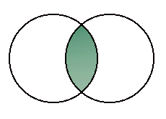
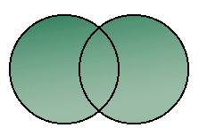
And, or, not
and
or
not
 | 0 | 1
0 | 0 | 0
1 | 0 | 1
 | 0 | 1
0 | 0 | 1
1 | 1 | 1
0 | 1
1 | 0

Slide 49
Logical Operators
_{>>> a = True}
_{>>> b = True}
_{>>> c = False}
_{>>> d = False}
_{>>> a and b}
_{True}
_{>>> a and c}
_{False}
_{>>> a or c}
_{True}
_{>>> not a}
_{False}

Slide 50
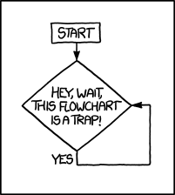
Flow Control
Different inputs → Different execution order
Illegal input
Different use cases
Control structures
if-else
for loop
while loop
http://xkcd.com/1195/

Slide 51
Conditional Statement: if
Used to execute statements conditionally
Syntax
if condition:
statement1
statement2
…
if condition is True, statements are executed
Condition = expression that evaluates to a Boolean
Indentation = determines the scope of the if block

Slide 52
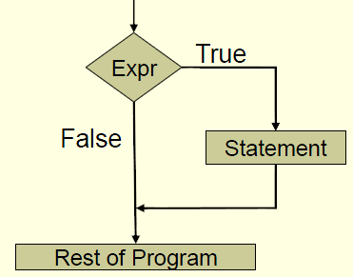
Conditional Statements

Slide 53
Conditional Statements - Examples
# num is a
multiplication
of 18
num = 54 # choose a number
if num % 18 == 0:
print(num, "is divisible by 18")
res = num / 18
print("Goodbye")
54 is divisible by 18
Goodbye

Slide 54
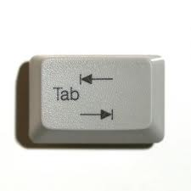
Conditional Statements
Indentation:
Following the if statement:
One tab to the right opens a new scope.
Indicates the commands within the scope of this if.

Slide 55
if-else
if condition1:
statement1
else:
statement2
rest of code
if condition1 is true → execute statement1
if condition1 is false → execute statement2
execute rest of code

Slide 56
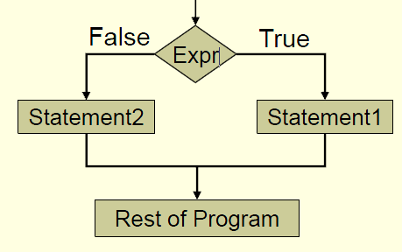
if-else

Slide 57
if-else
if width == height:
print("found a square")
else:
print("found a rectangle")
print(“done”)
Indentation:
else is not a part of the if scope!
The commands under else are indented.

Slide 58
if-else
a = 4
b = 5
c = 6
if a + b > c and a + c > b and b + c > a:
print("Building a triangle")
else:
print("Cannot build a triangle")

Slide 59
if-elif-else
if condition1:
statement1
elif condition2:
statement2
else:
statement3
rest of code
condition1 is true → execute statement₁
condition1 false and condition2 true → execute statement2
condition1 and condition2 are false → execute statement3
execute rest of code
elif = else-if

Slide 60
if-elif-else
if price < 100:
print("too cheap")
elif price > 200:
print("too expensive")
else:
print("reasonable price")

